Slide 1
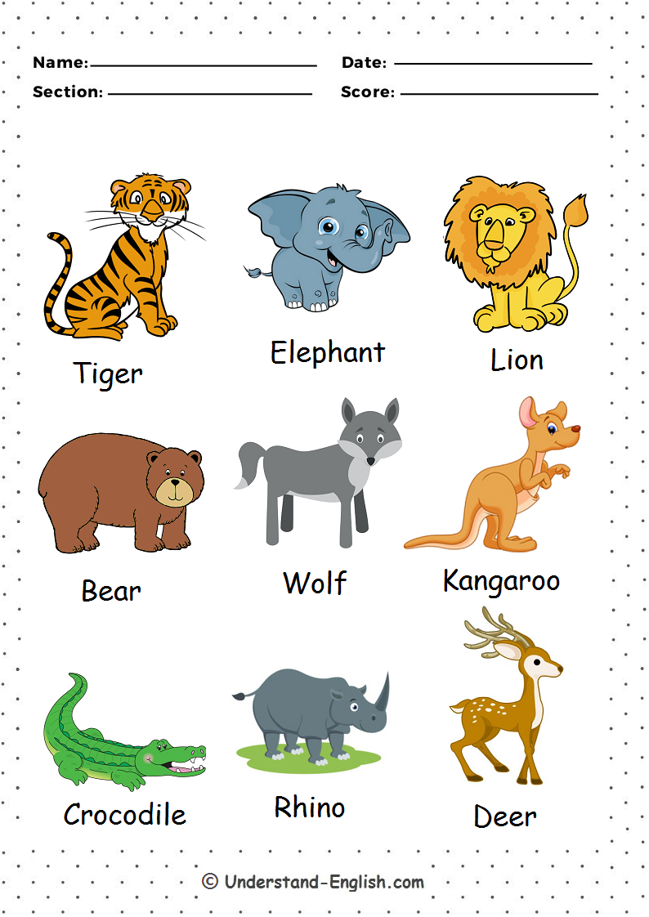

tiger elephant lion
bear wolf kangaroo
crocodile rhino fish

